Slide 1
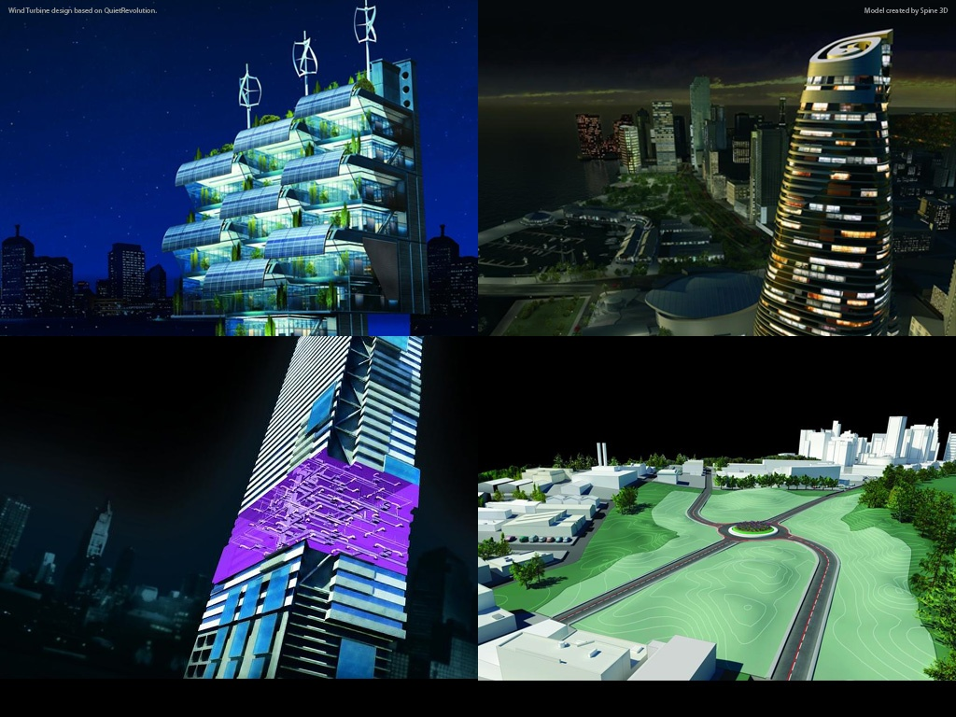
Autodesk AEC Developer’s Camp 2010 Presenting Your Analysis Data in Revit
Harry Mattison
Principal Engineer – Revit API Development
Notes:
AEC Title

Slide 2
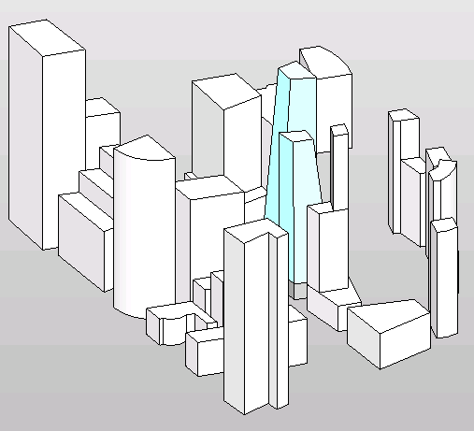
How do you go from this…

Slide 3
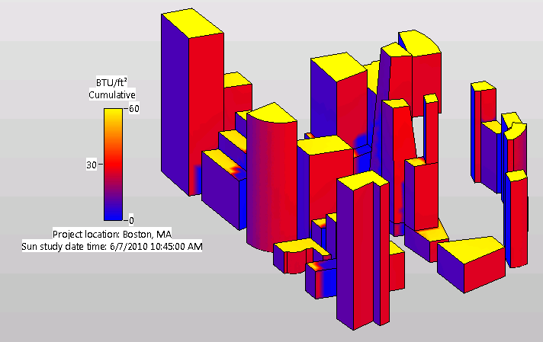
To this?

Slide 4
The Answer is… The Revit Analysis Visualization Framework

Slide 5
Analysis Visualization Framework (AVF)
New in 2011
Used by the Autodesk Solar Radiation Technology Preview for Revit http://labs.autodesk.com/utilities/ecotect/overview/
Allows you to display data in Revit based on faces, curves, and free points
Results data and display are not persistent in the Revit model. Images can be saved in the Revit model or exported.
Now let’s see first hand how it works and what it can do!

